Slide 1
Law Enforcement Update
OHV Administrator Jake Holsclaw
April 13, 2024

Slide 2
Thank You Safety Instructors!
You answered the call
2823 students certified at in-person classes
10,558 students certified online
13,381 students certified in 2023! 5% increase from 2022.
174 ATV safety classes completed in 2023 up from 137 in 2022. 21% increase!

Slide 3
Saving Lives Initiative
Statewide effort to reduce injuries and deaths – safety is our #1 priority
Sheriff's departments can apply for and receive aid for up to 100% of their patrol costs through the DNR
Efforts by WATVA increased the patrol reimbursement to $1.3 million statewide for these patrols
Law enforcement patrols – 38,249 hours logged by wardens and deputies
Equivalent to 18 full time positions

Slide 4
Think Smart Before You Start
Statewide safety enhancement effort August 4 – 6
7 intoxicated operators removed from public routes and trails, 1 illegal drug violation
Nearly 500 ATV/UTV riders contacted
150 violation warnings issued
1,400 miles of trail patrolled

Slide 5
Top Citations
386 – Unauthorized operation of all-terrain vehicle or utility terrain vehicle on or in the vicinity of highways
323 – Operate or ride all-terrain vehicle or utility terrain vehicle without required headgear
220 – Give permission to operate all-terrain vehicle or utility terrain vehicle without valid registration
192 – Operate all-terrain vehicle without valid safety certificate
170 – Operate ATV/UTV under the influence of an intoxicant
#1

Slide 6
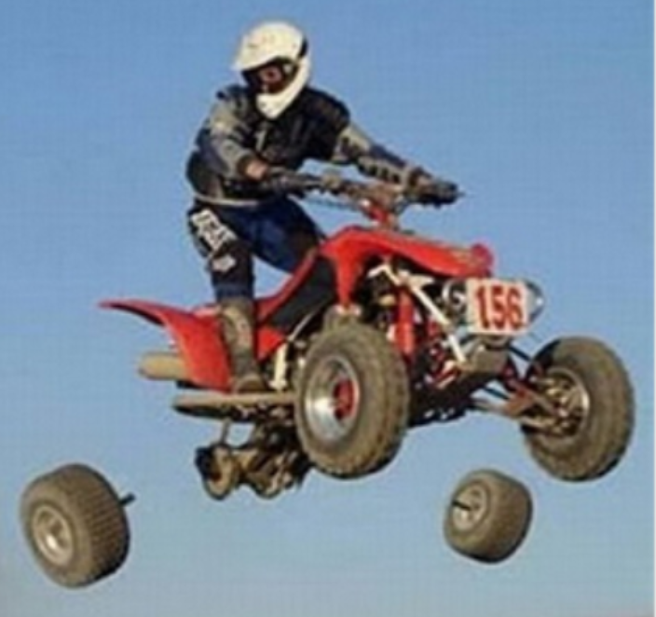
Top Reasons for Crashes
Alcohol use
Excessive speed
Inexperience
Careless Operation
Sharp turns
Restricted visibility

Slide 7
Helmet and Seatbelt Use
Sobering numbers……
32 fatal ATV and UTV crashes in 2023
Only 1 person was wearing a helmet
57% of UTV victims were not wearing a seatbelt
58% of fatal crashes occurred on a roadway
We encourage patrols to focus in the right areas

Slide 8
2023 – 2024 winter safety messaging
  Unique winter with lack of open snowmobile trails
  The department adjusted safety messaging to accommodate the changing seasons
  Ice safety with rec vehicles
    2 fatalities this year involved ice
  Traveling on snow covered roads

Slide 9

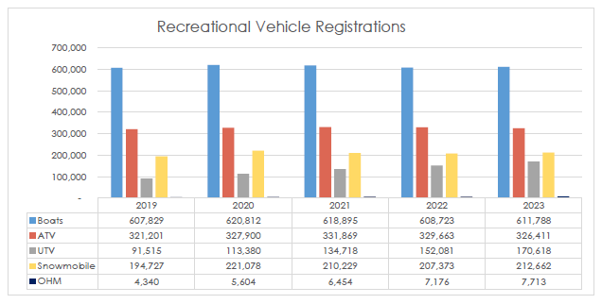
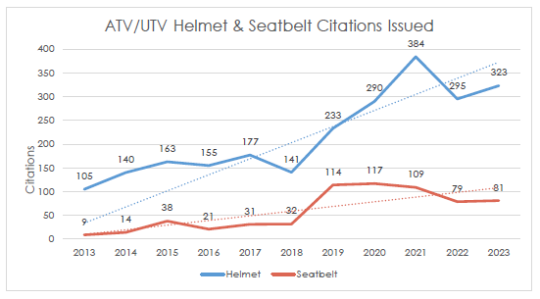
https://dnr.wisconsin.gov/topic/ATV/CrashInfo

Slide 10
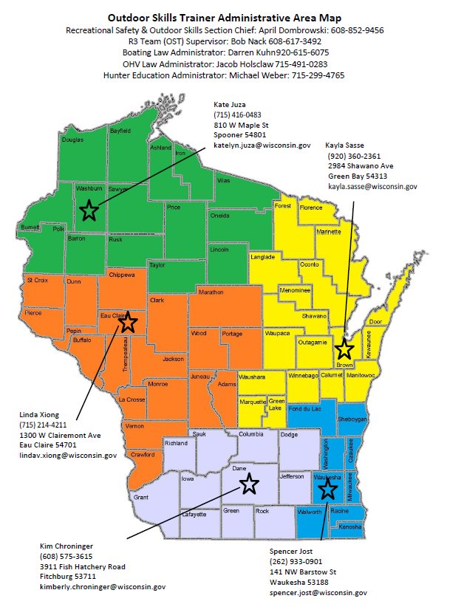
Outdoor Skills Trainers
Currently 4 statewide
Train new instructors
Your go to for questions with anything safety class related
Current vacancy in Spooner – touch base with Linda or Kayla for northern class questions
Vacant

Slide 11
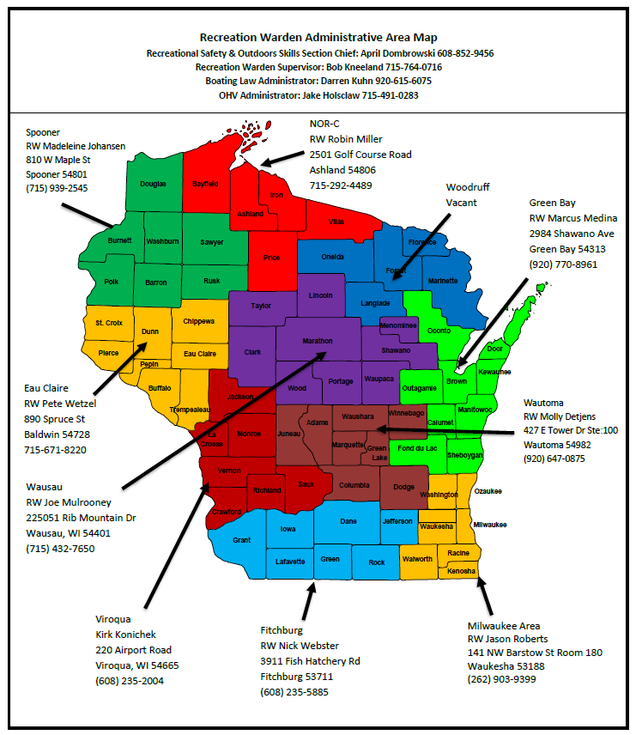
Recreation Warden Team
Currently 9 statewide
Complex crash investigations
Hunting incidents
Recreational vehicle patrol
Coordinating safety enhancement efforts
Working with partners
Special events
Rec vehicle training within DNR
Training for sheriff’s departments

Slide 12
Questions?

Slide 13
Jake Holsclaw
Jacob.Holsclaw@wisconsin.gov
715-491-0282

