Slide 1
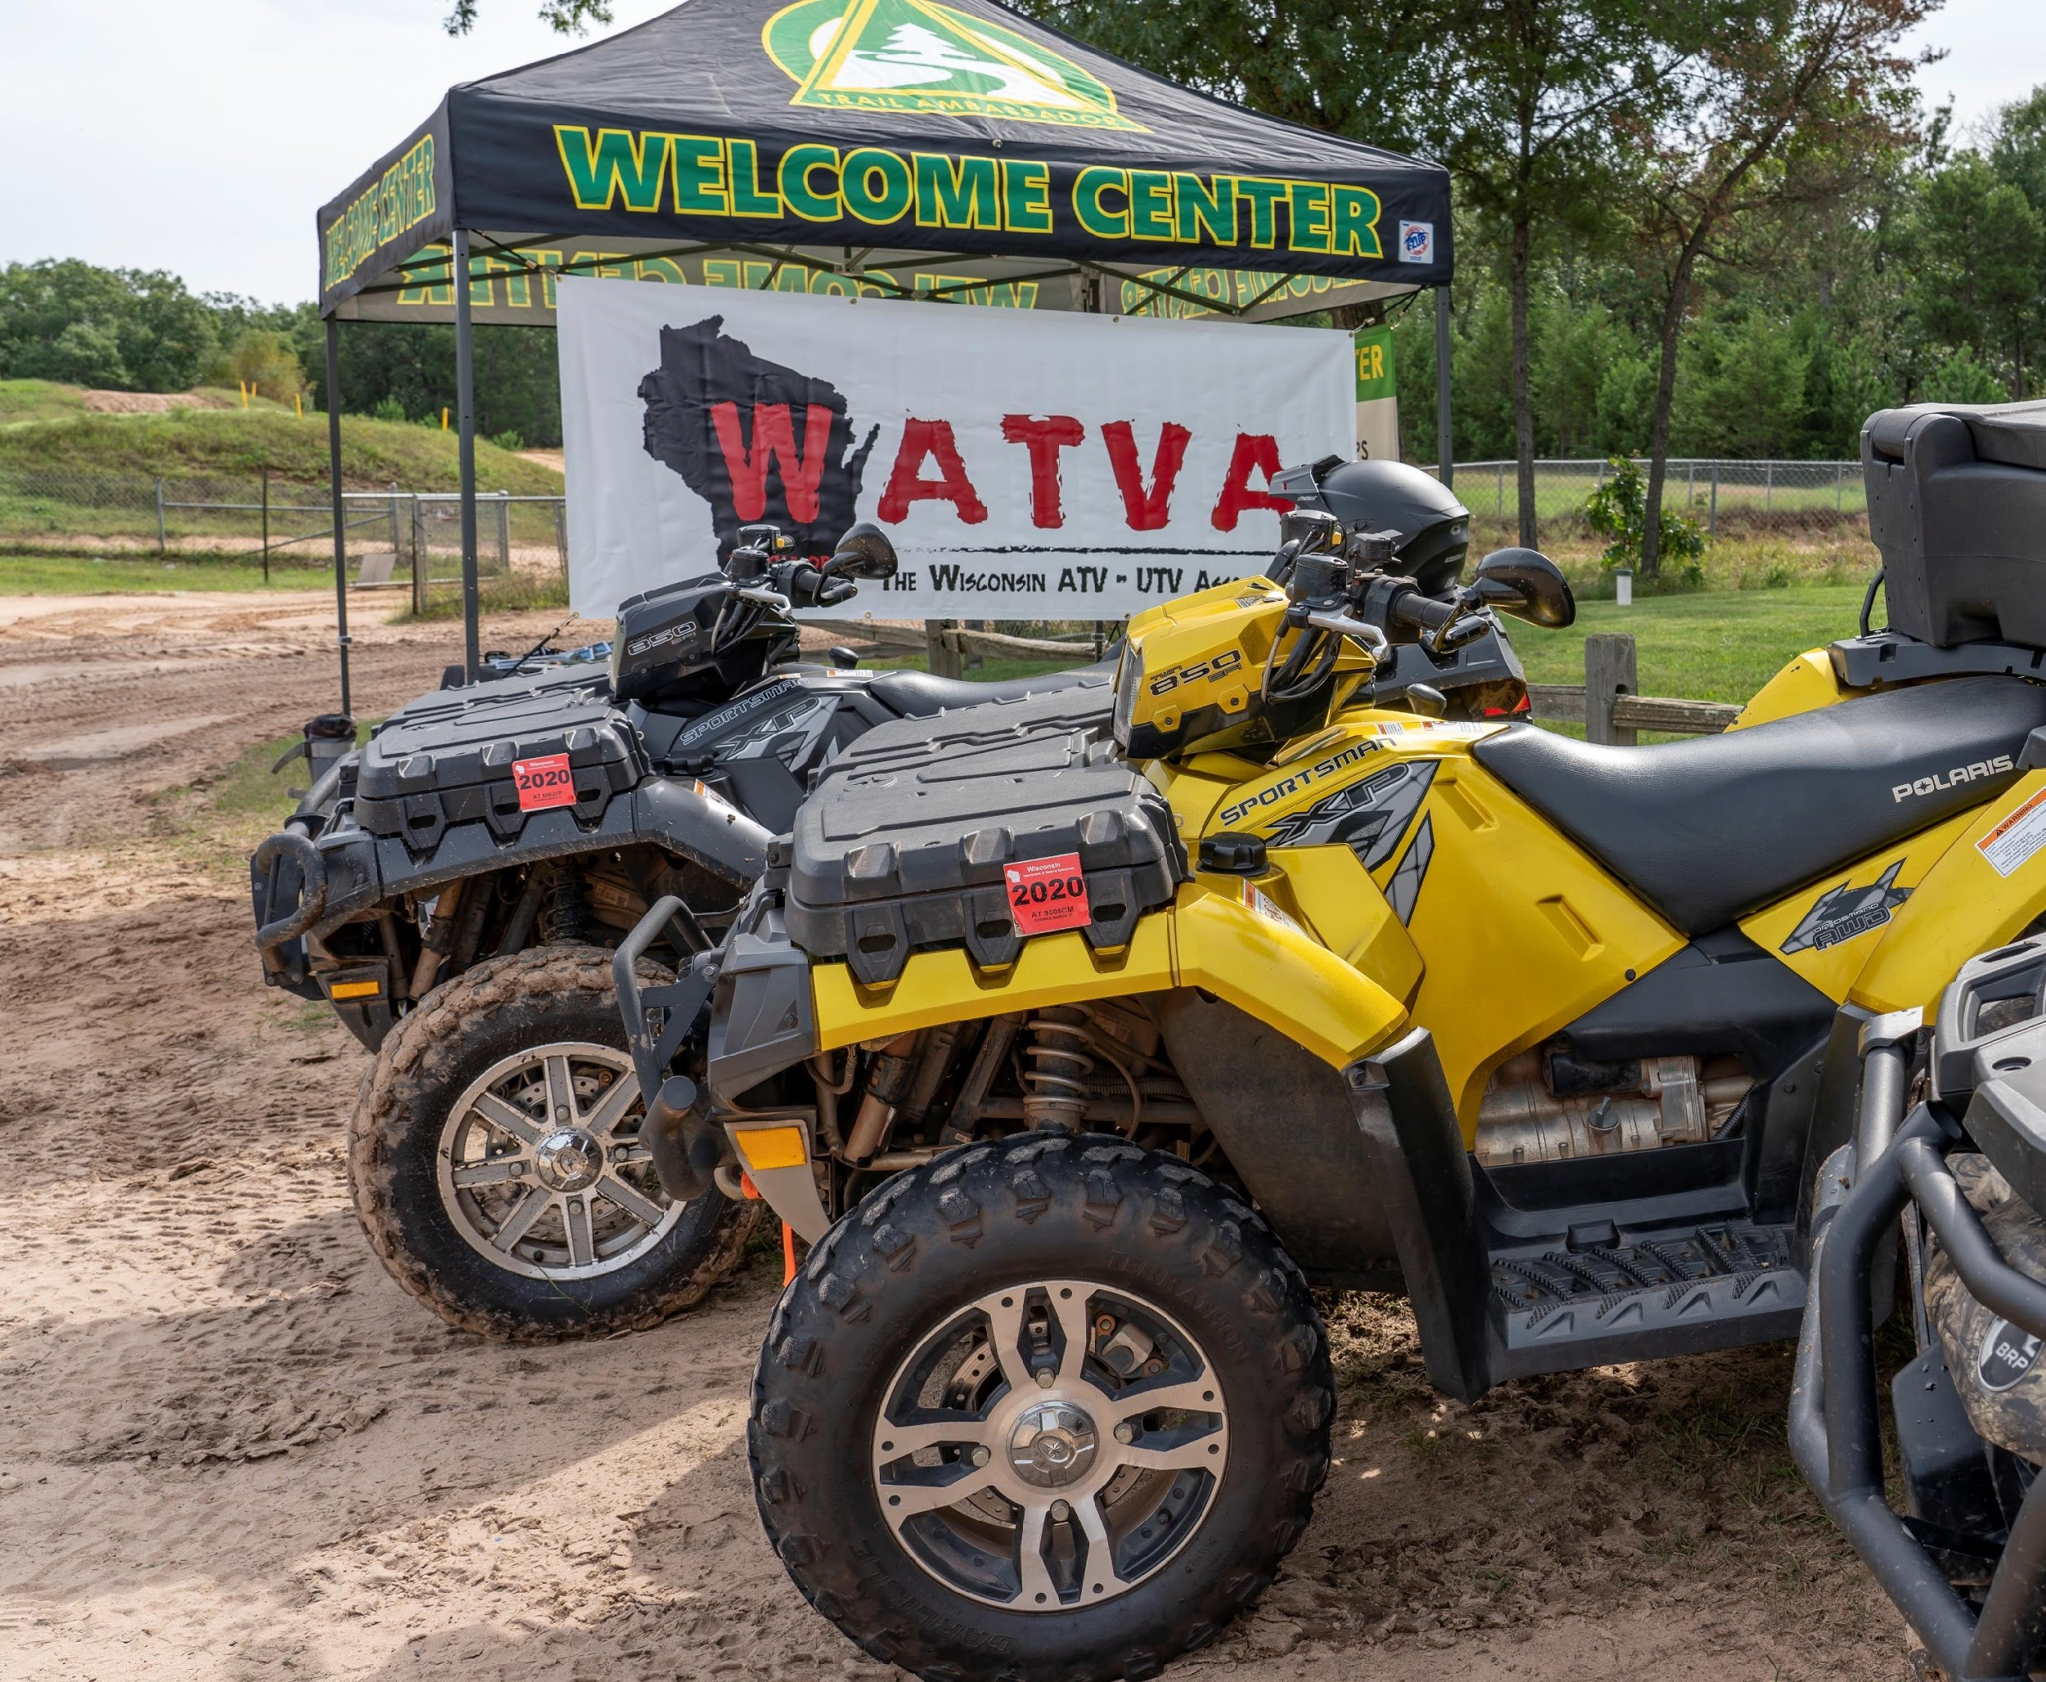

Wisconsin Registration Programs supported by the WATVA & the NOHVIS Group

Slide 2
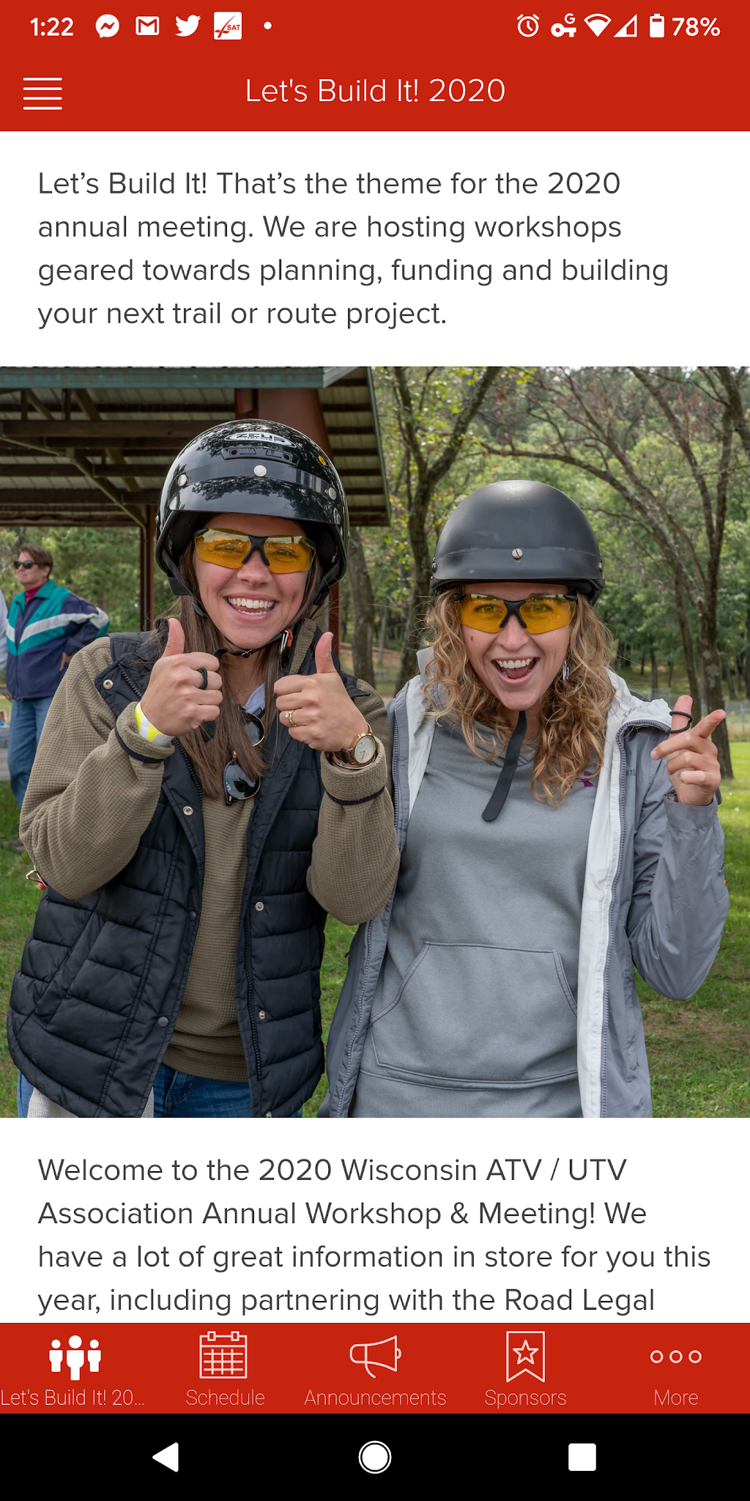
Main Objectives
Promote a positive image
Educational programs
Encourage awareness of impacts all riders have

Slide 3


Slide 4
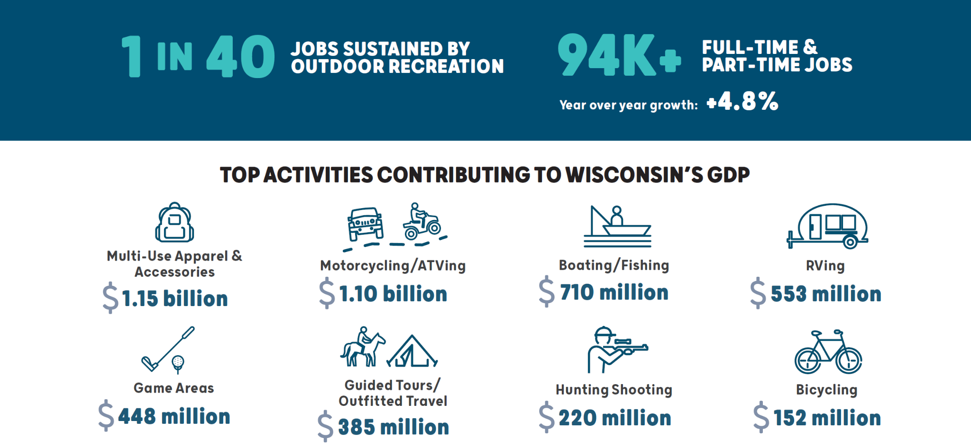

Slide 5
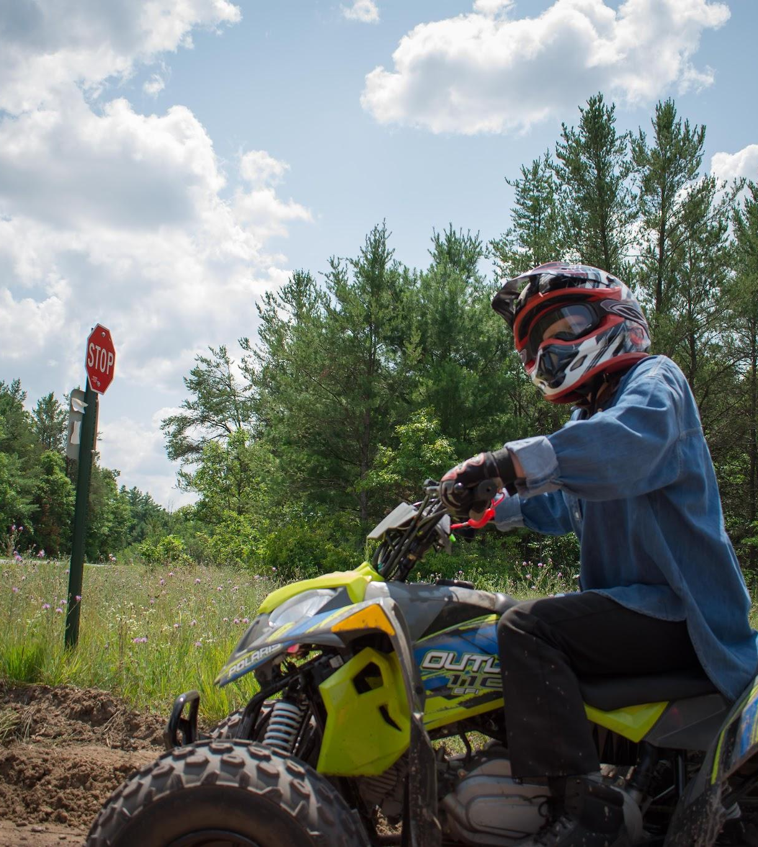
Economic Impact 2023
Economic Impact of the Industry & ATV / UTV Riders in Wisconsin
Calendar Year 2023 by Daniel Lee Consulting LLC

Slide 6
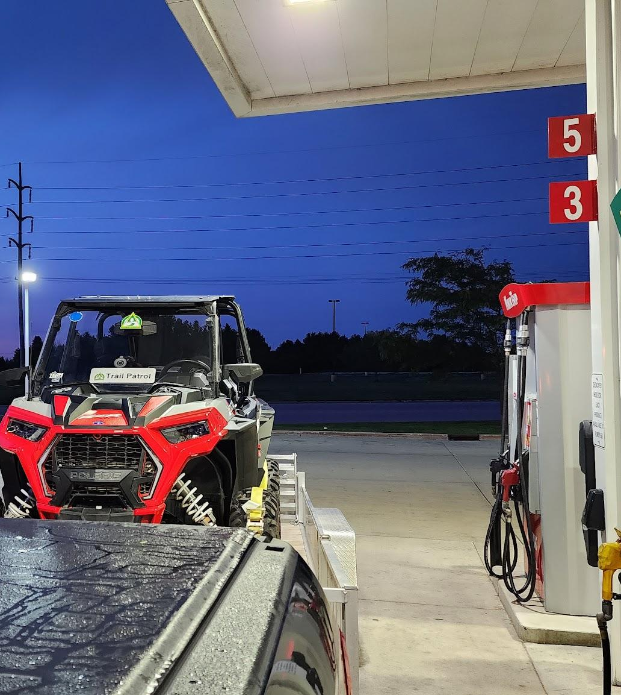
Direct Spending
Includes dealerships, lodging, restaurants, fuel stops & retail stores

Slide 7
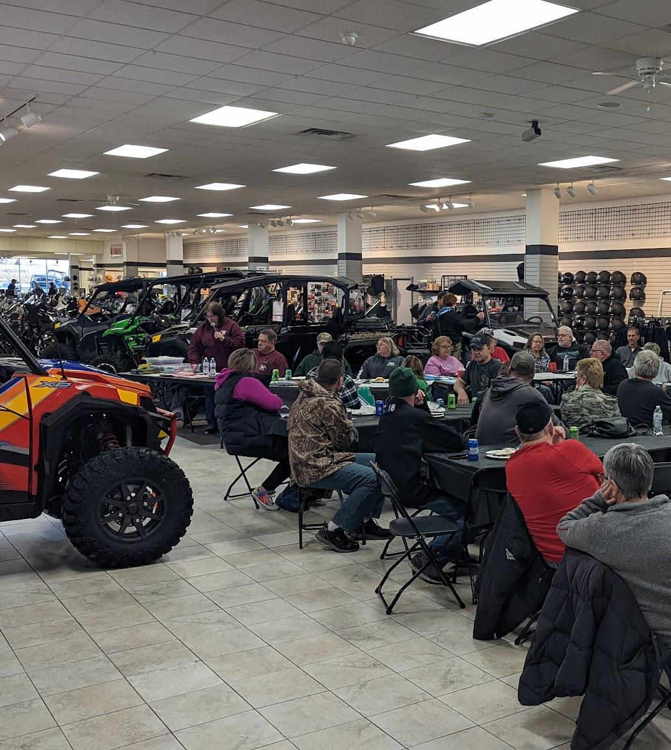
Direct Spending
Spending =
$4.2 Billion
Jobs =
25,845

Slide 8
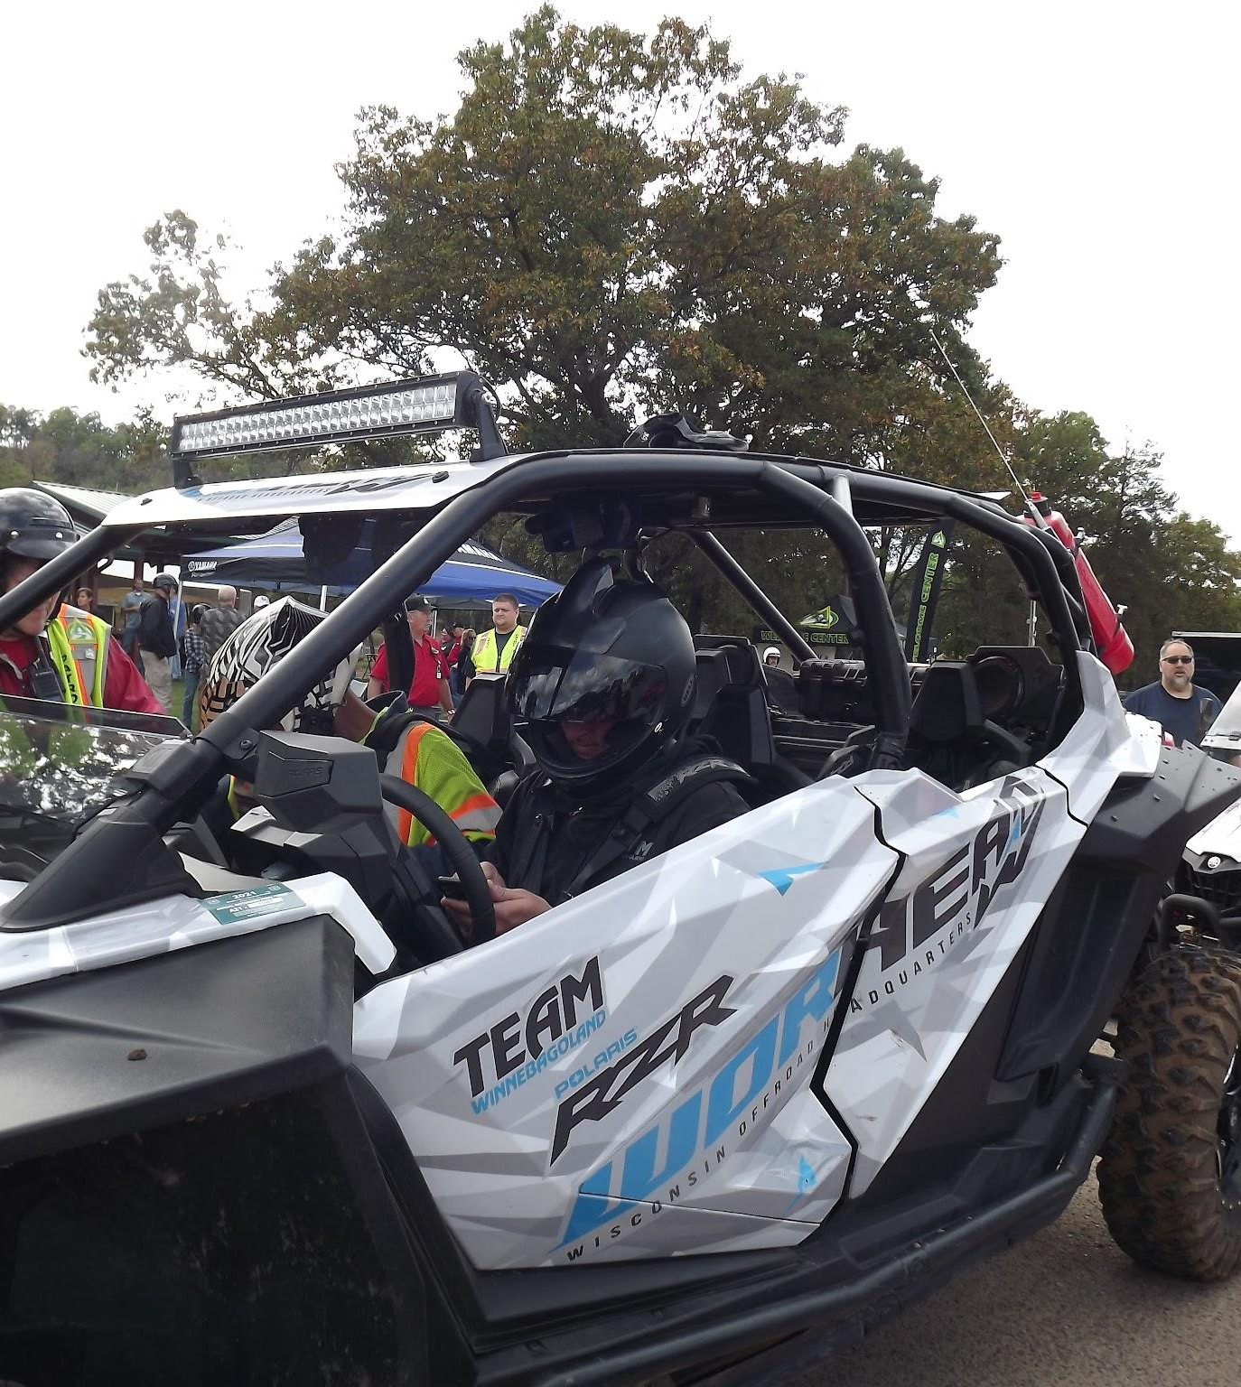
Total Economic Effect
Impact on Other Industries
Equals Rider Spending + Interindustry & Other Household Spending (aka Ripple Effect)

Slide 9
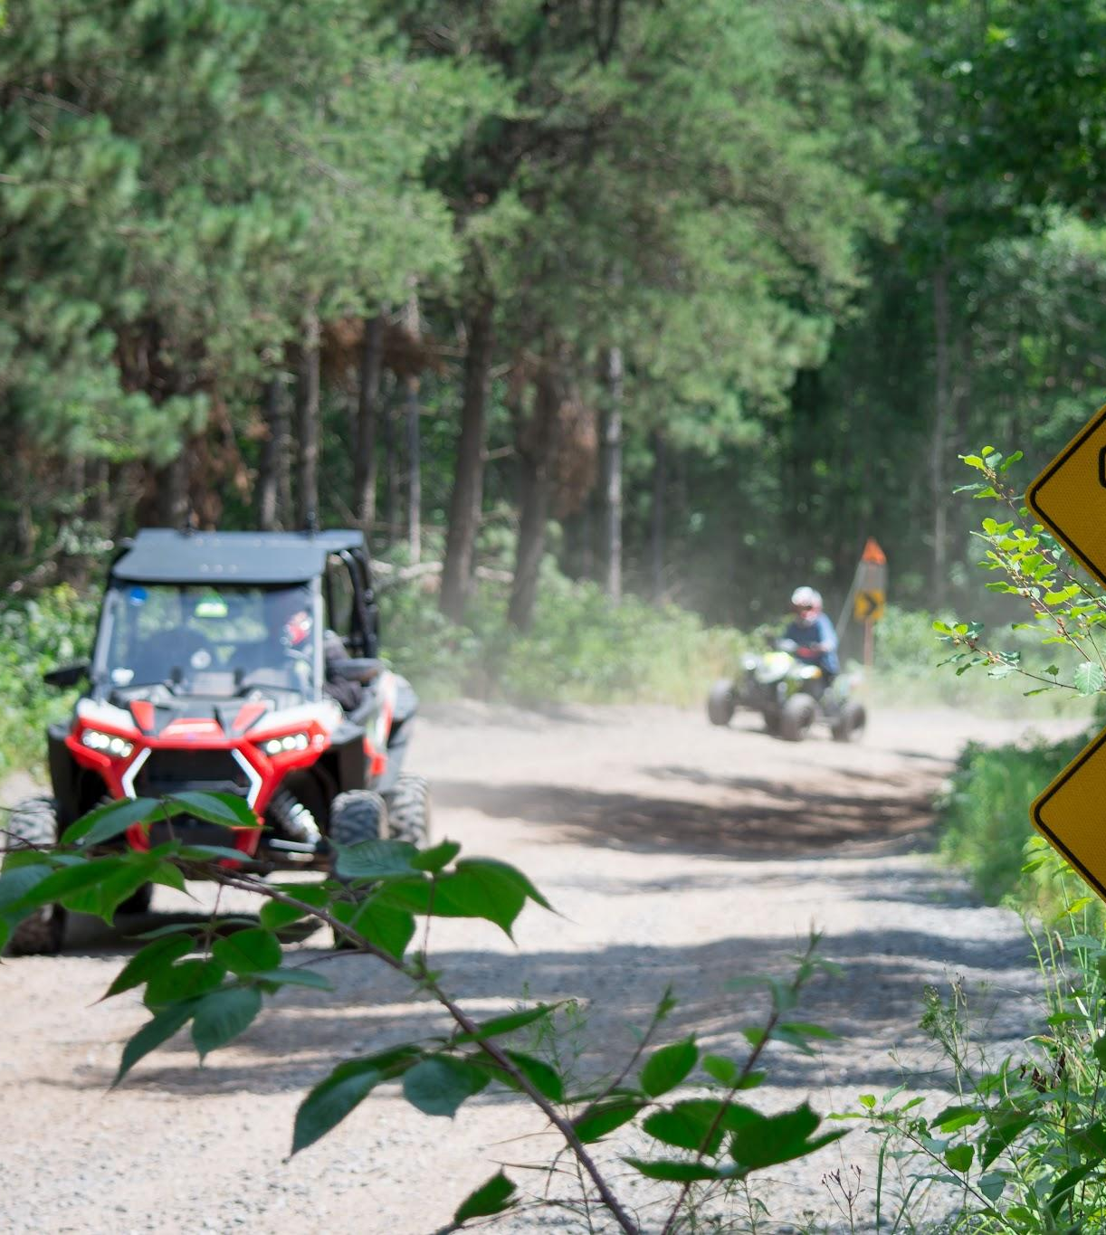
Total Economic Effect
Total Impact =
$5.4 Billion
Jobs =
39,804

Slide 10
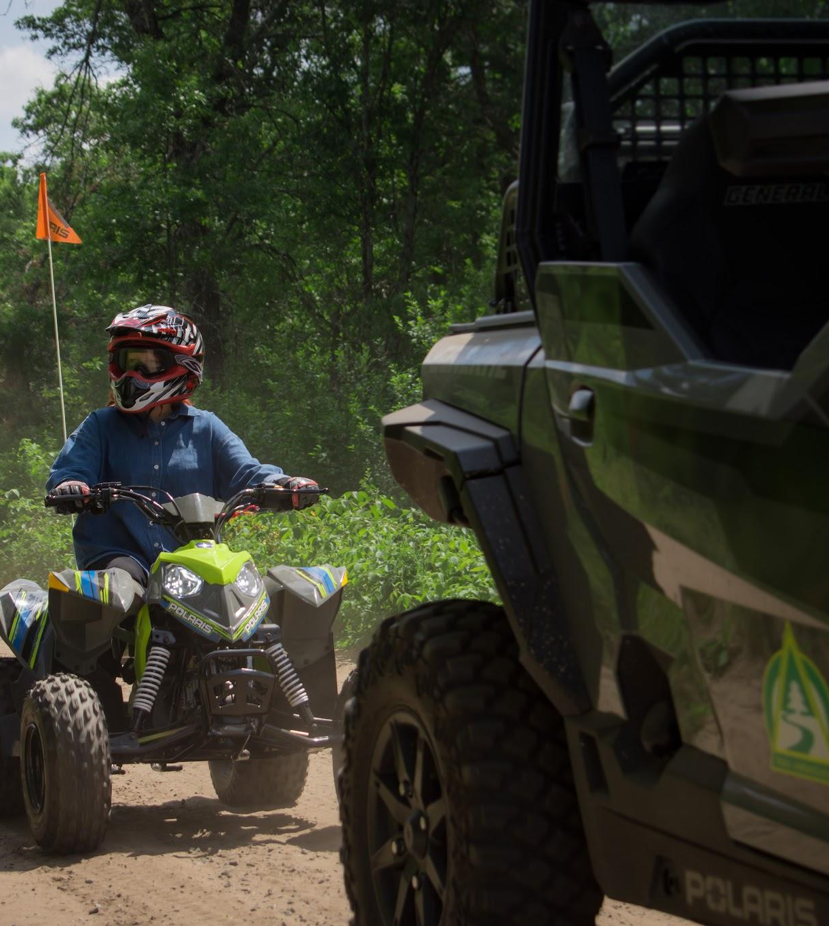
Total Effects in Perspective
39,804 jobs =
1.03% of all employment in Wisconsin

Slide 11
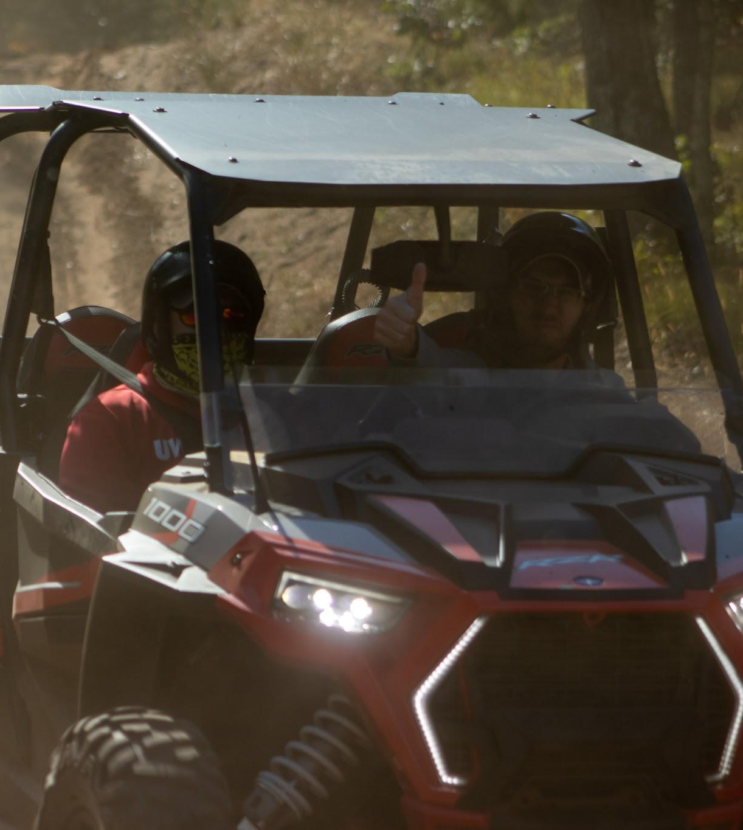
Total Effects in Perspective
Contribution to state and local taxes =
$435.4 million of tax revenue

Slide 12
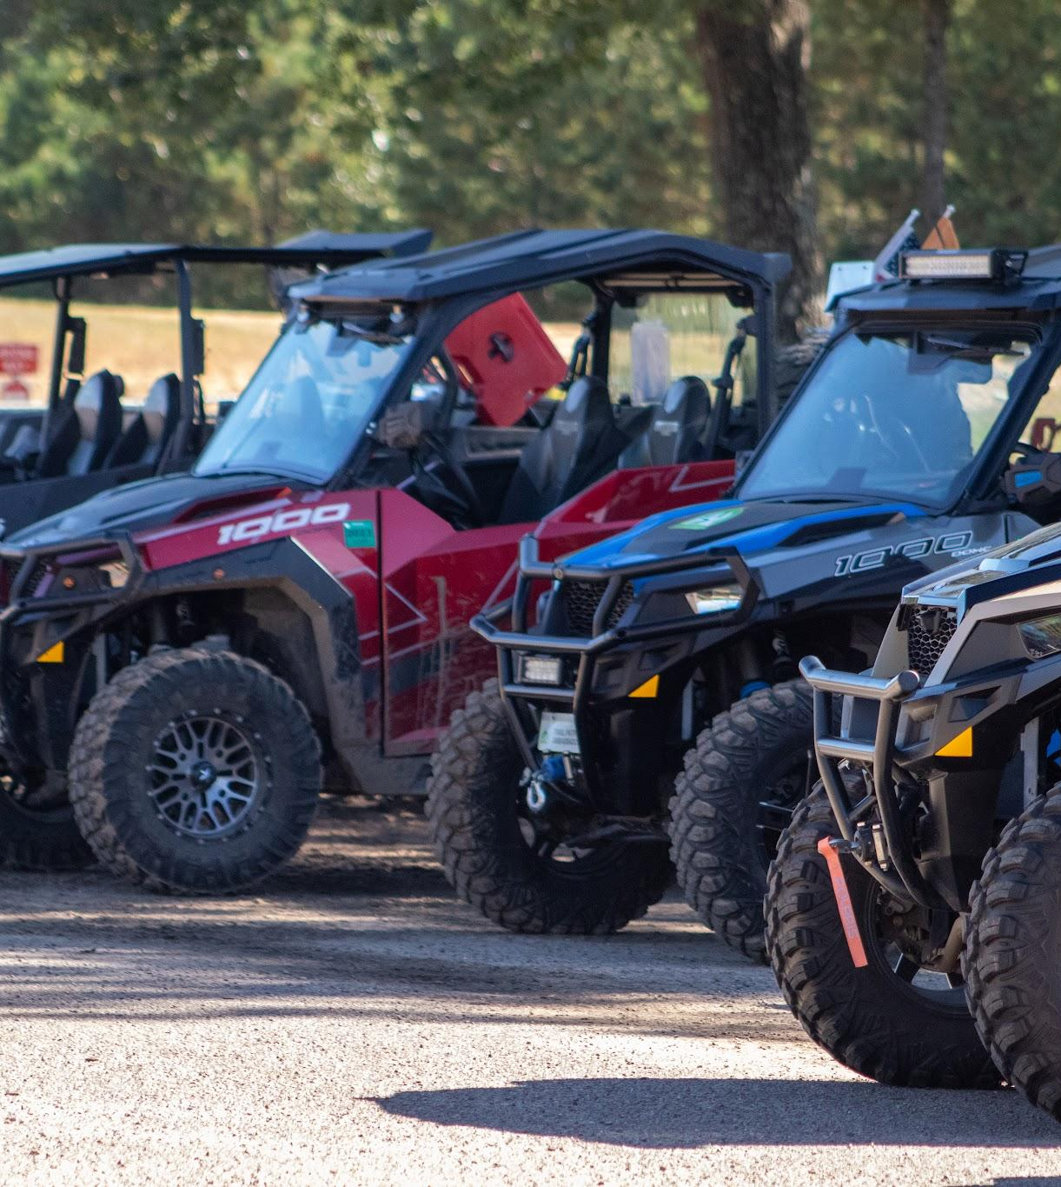
Total Effects in Perspective
ATV UTV economic contributions to Wisconsin’s economy are significant and poised for further growth

Slide 13
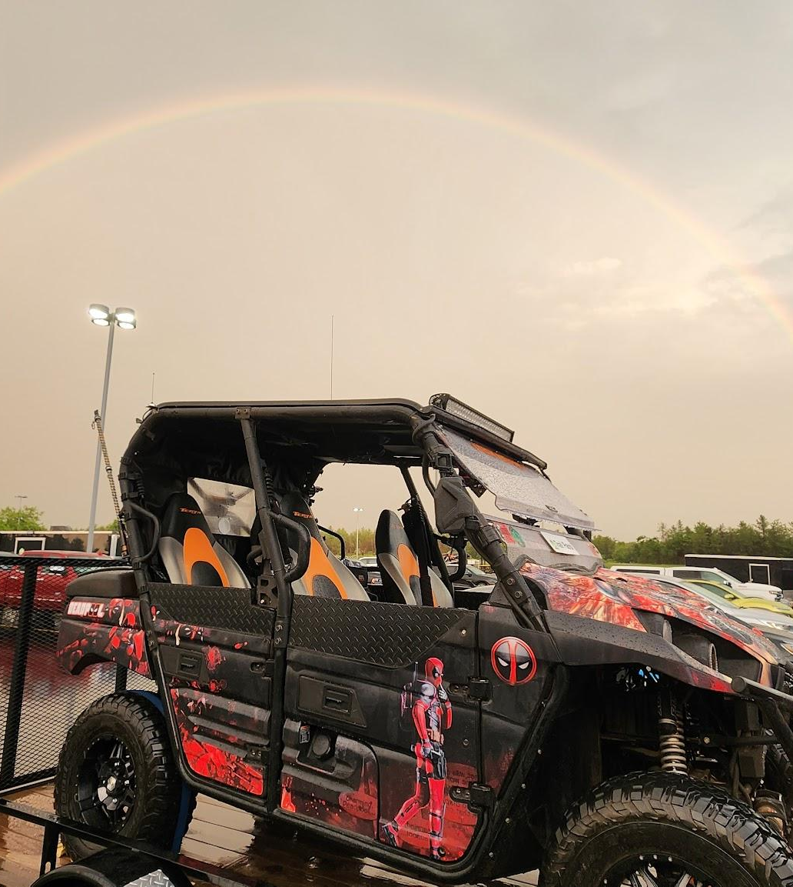
Total Effects in Perspective
National statistics underscore Wisconsin’s leading position in terms of economic production or impact, even when adjusting for population size vs other states

Slide 14
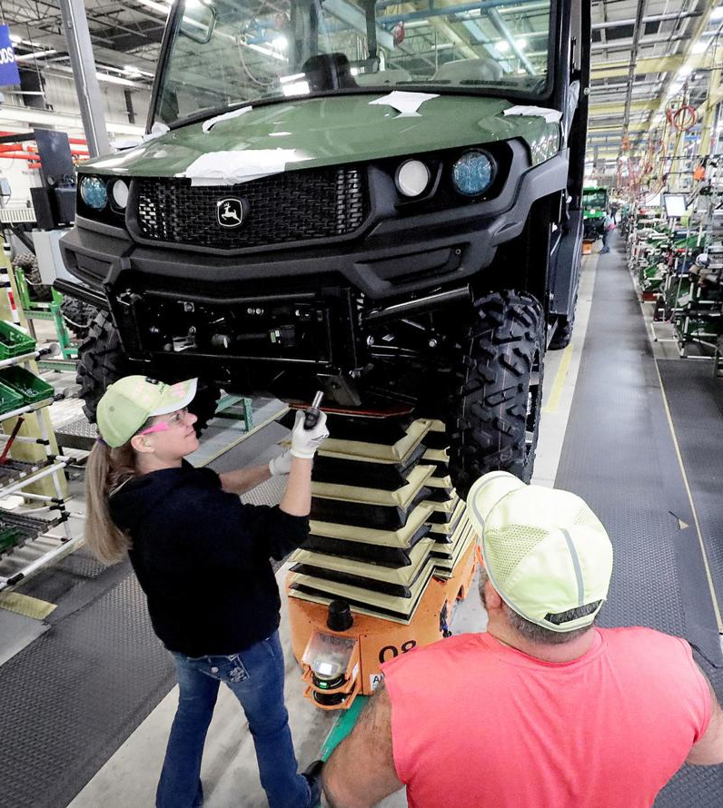
Total Effects in Perspective
The presence of ATV UTV manufacturing in Wisconsin amplifies the industry’s economic impact beyond just service sectors

Slide 15
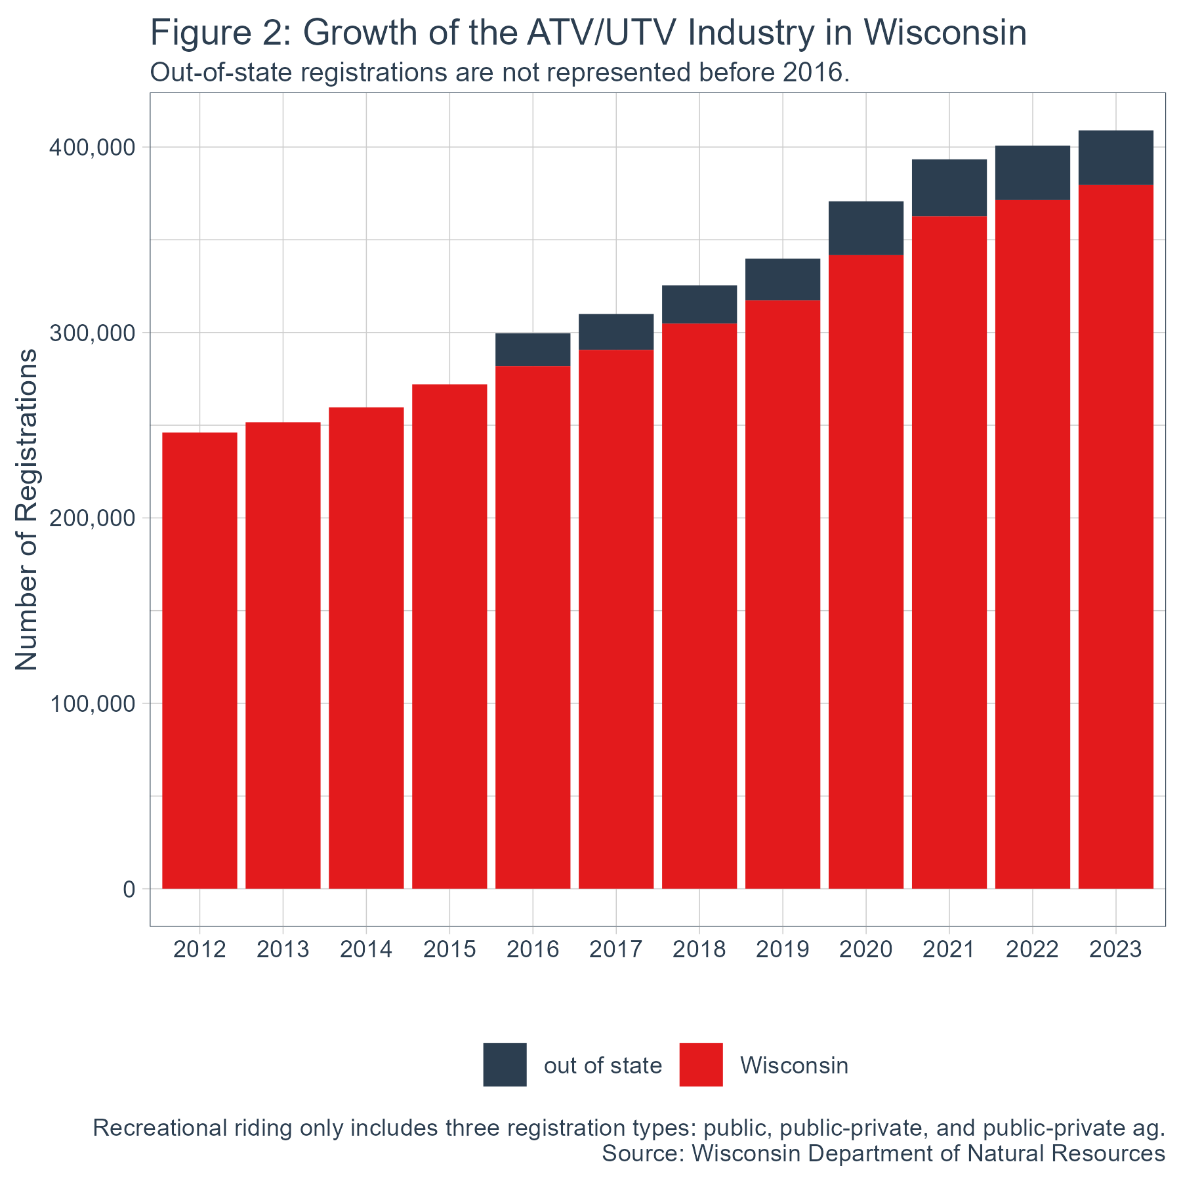

Slide 16
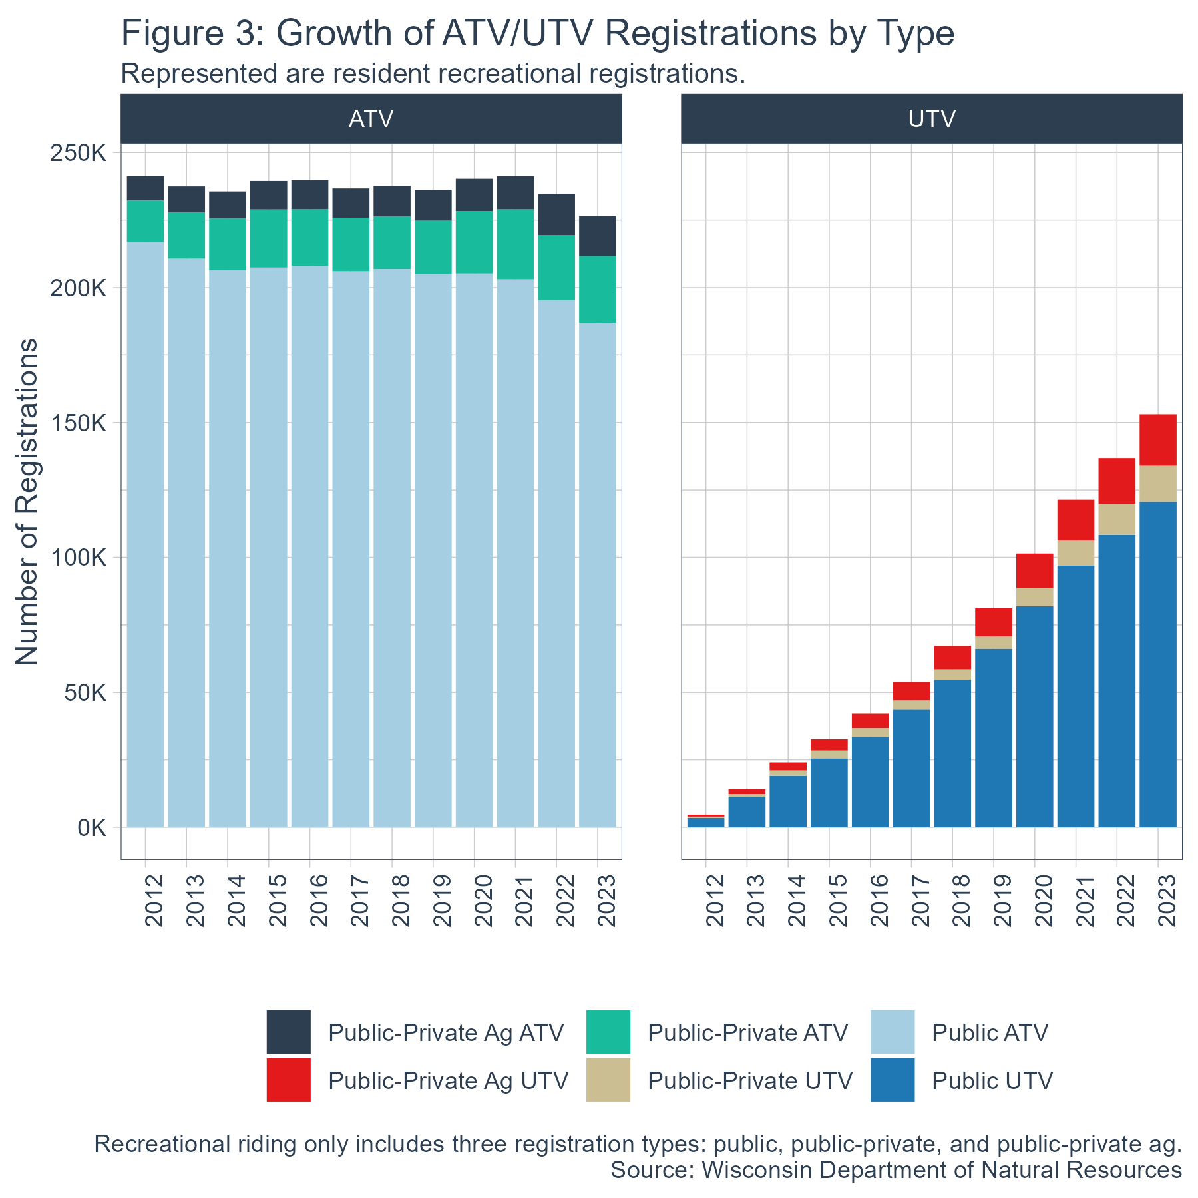

Slide 17
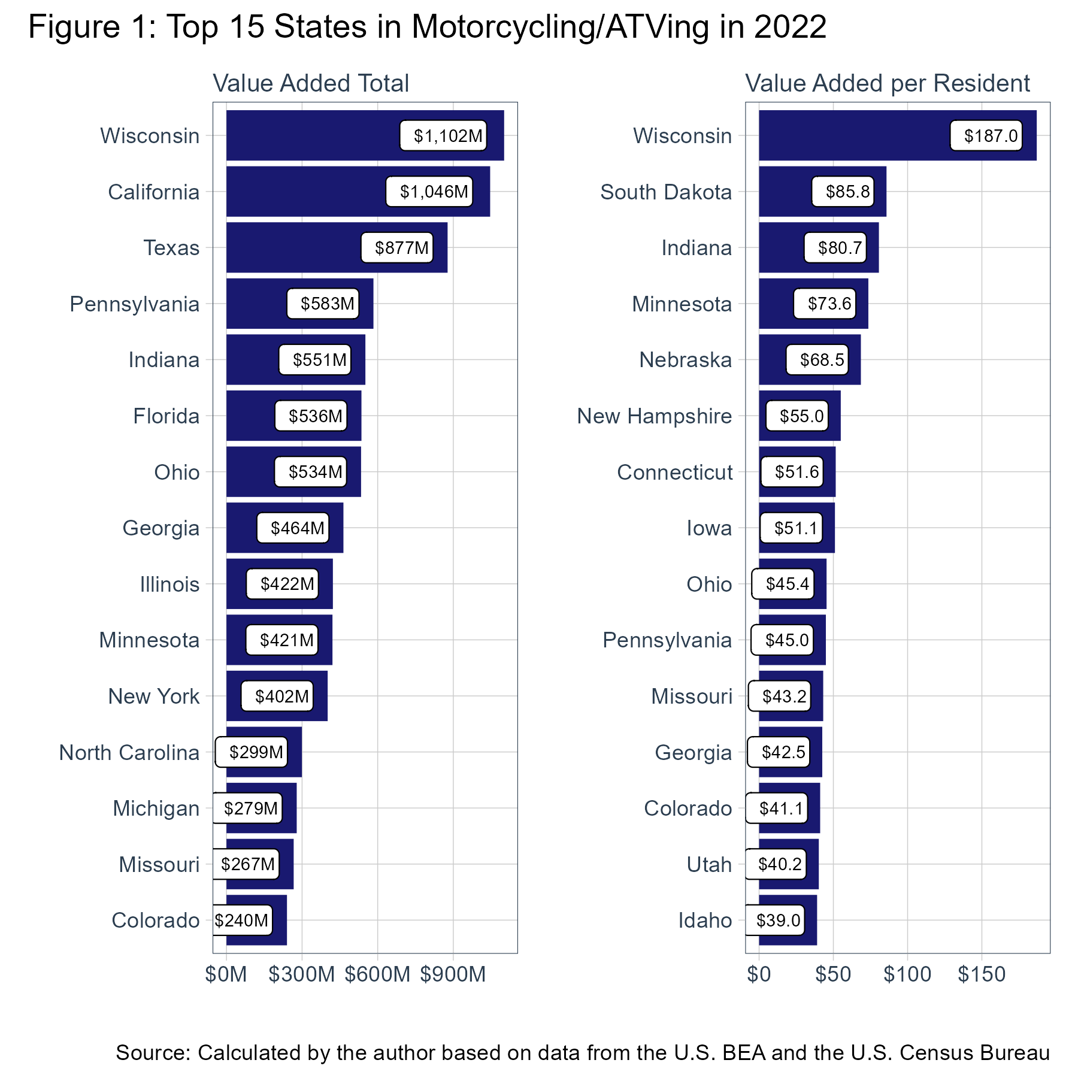

Slide 18
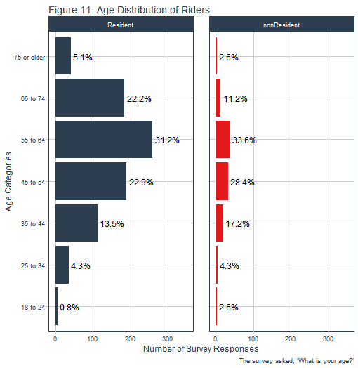

Slide 19
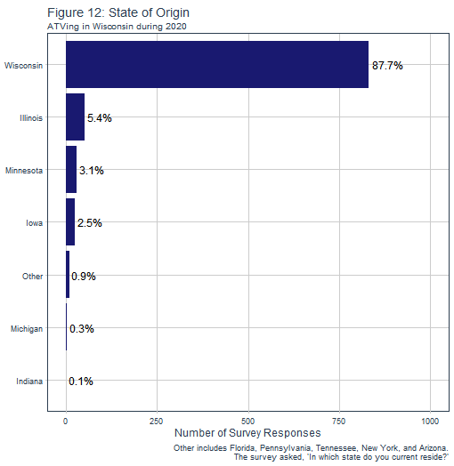

Slide 20
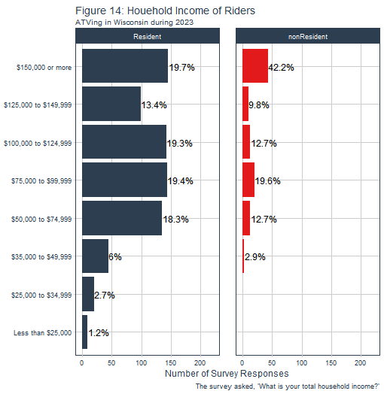

Slide 21
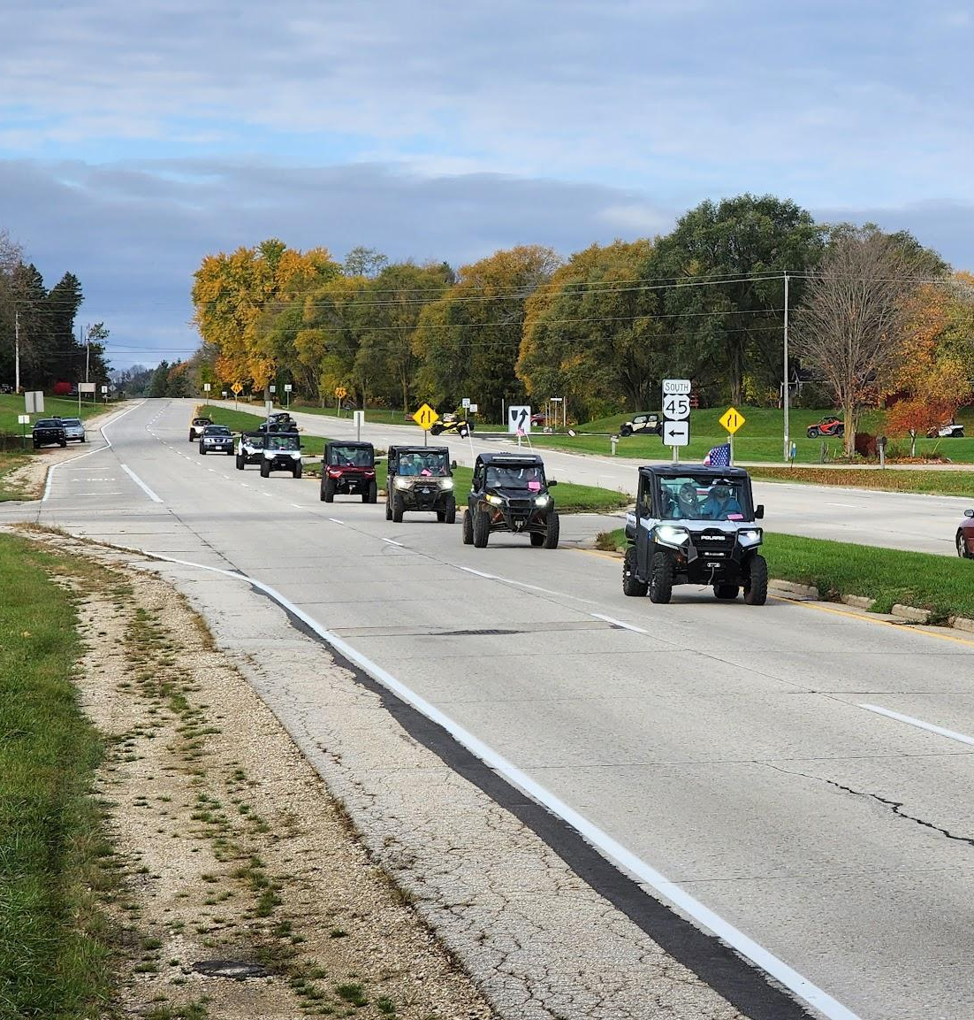
62,577+ miles of legal road routes, expansion continues
1,100 + ordinances including towns, villages and cities
Currently 35 counties have ATV / UTV ordinances
6,800 miles of summer & winter trails statewide

Slide 22
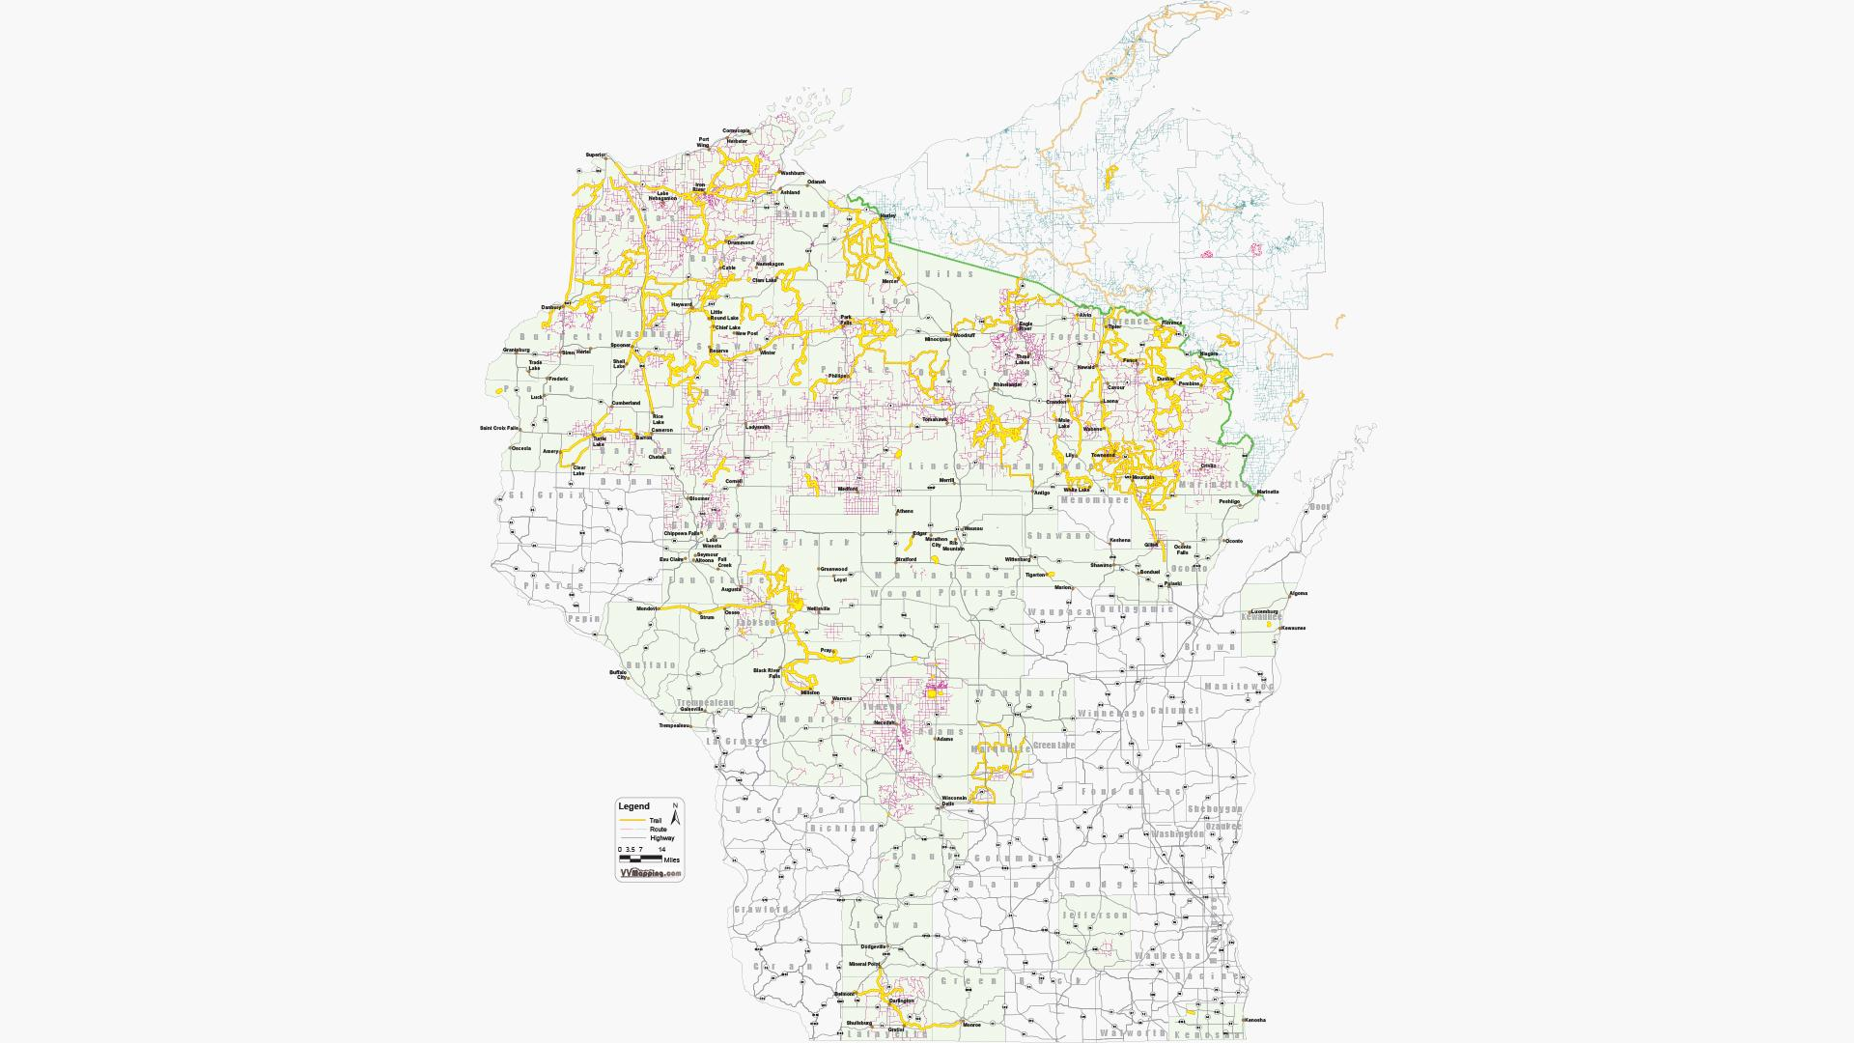
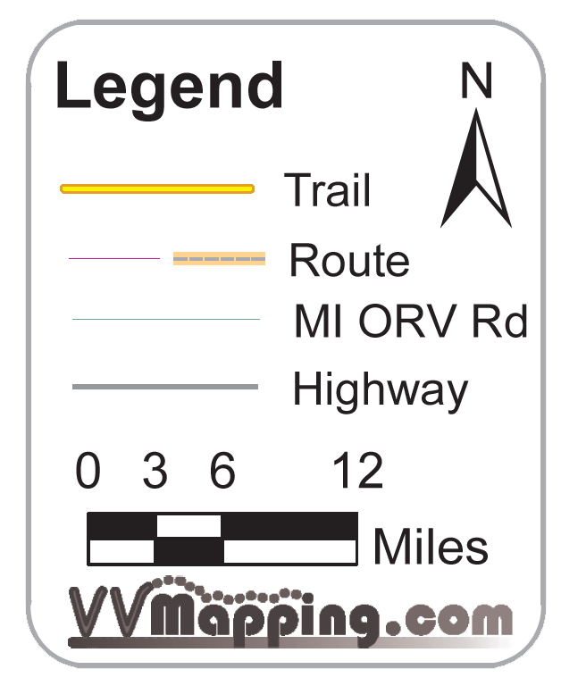

2017

Slide 23
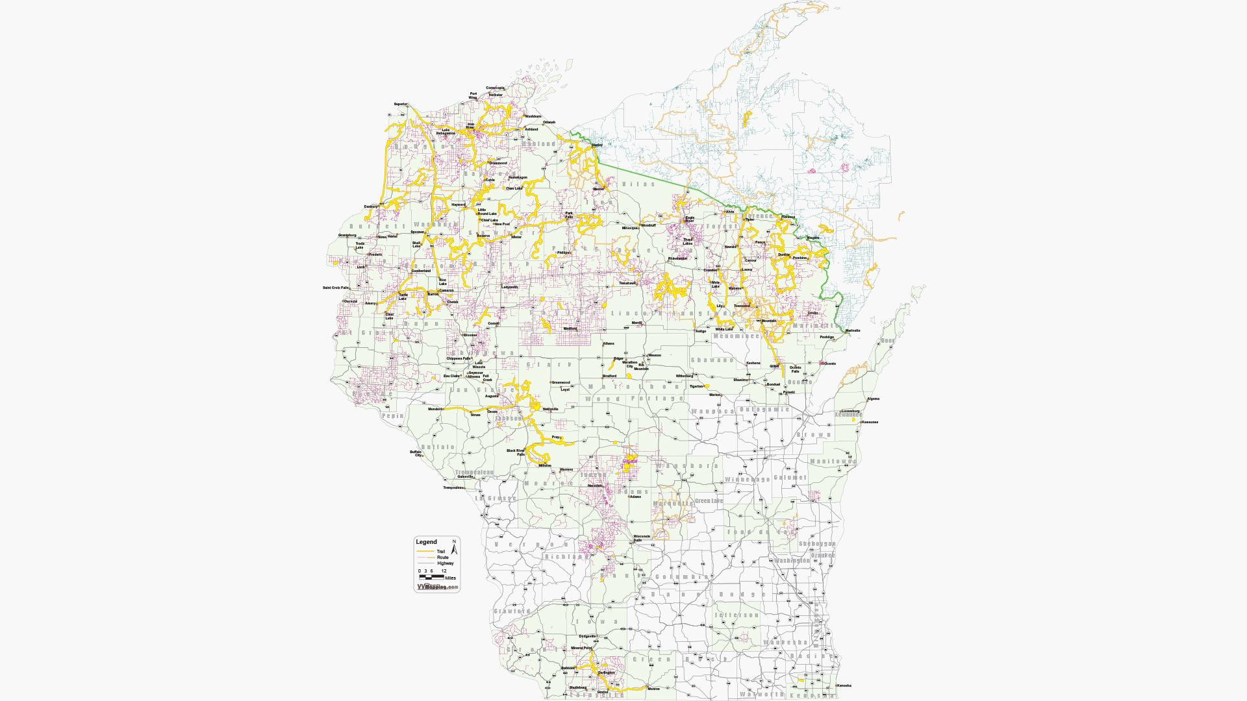
2018

Slide 24
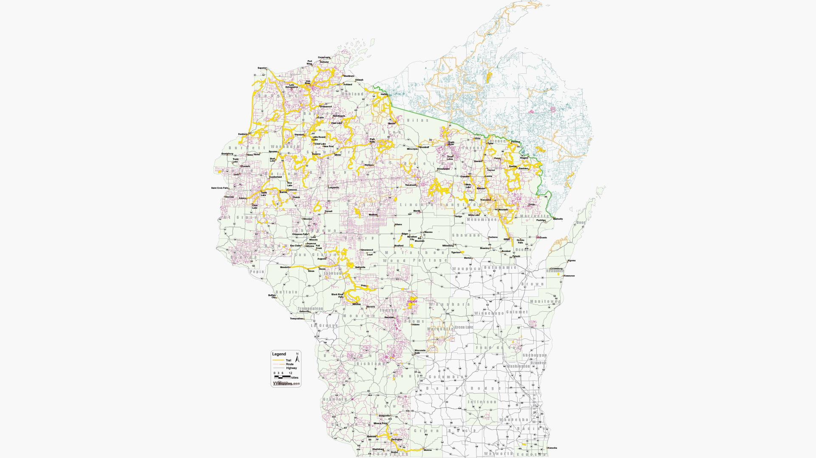
2019

Slide 25
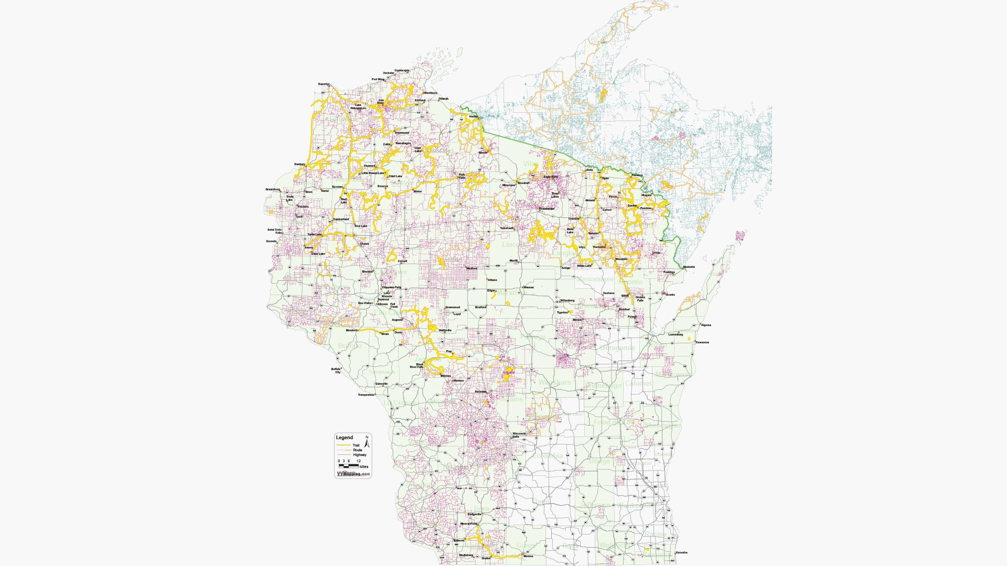
2020

Slide 26
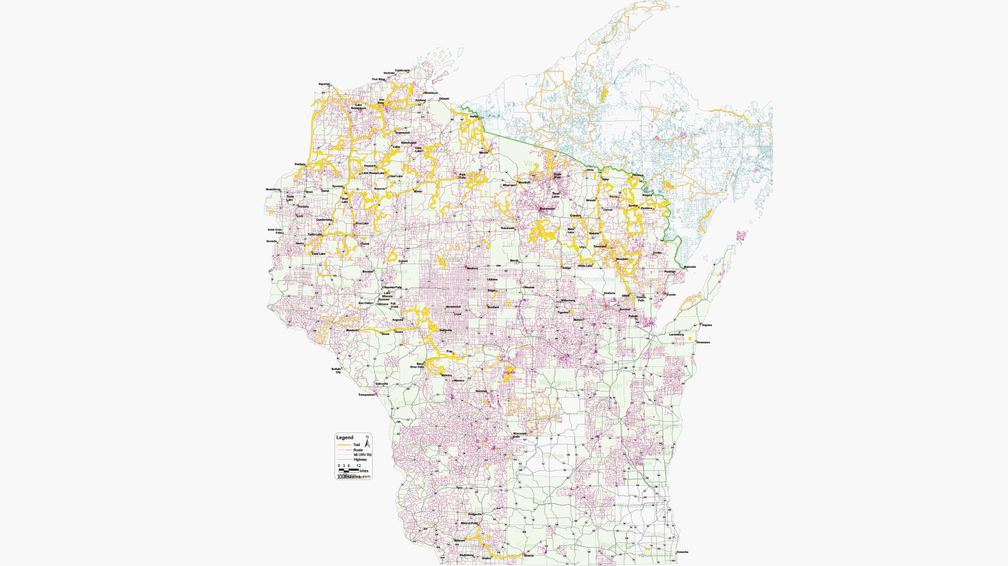
2021

Slide 27
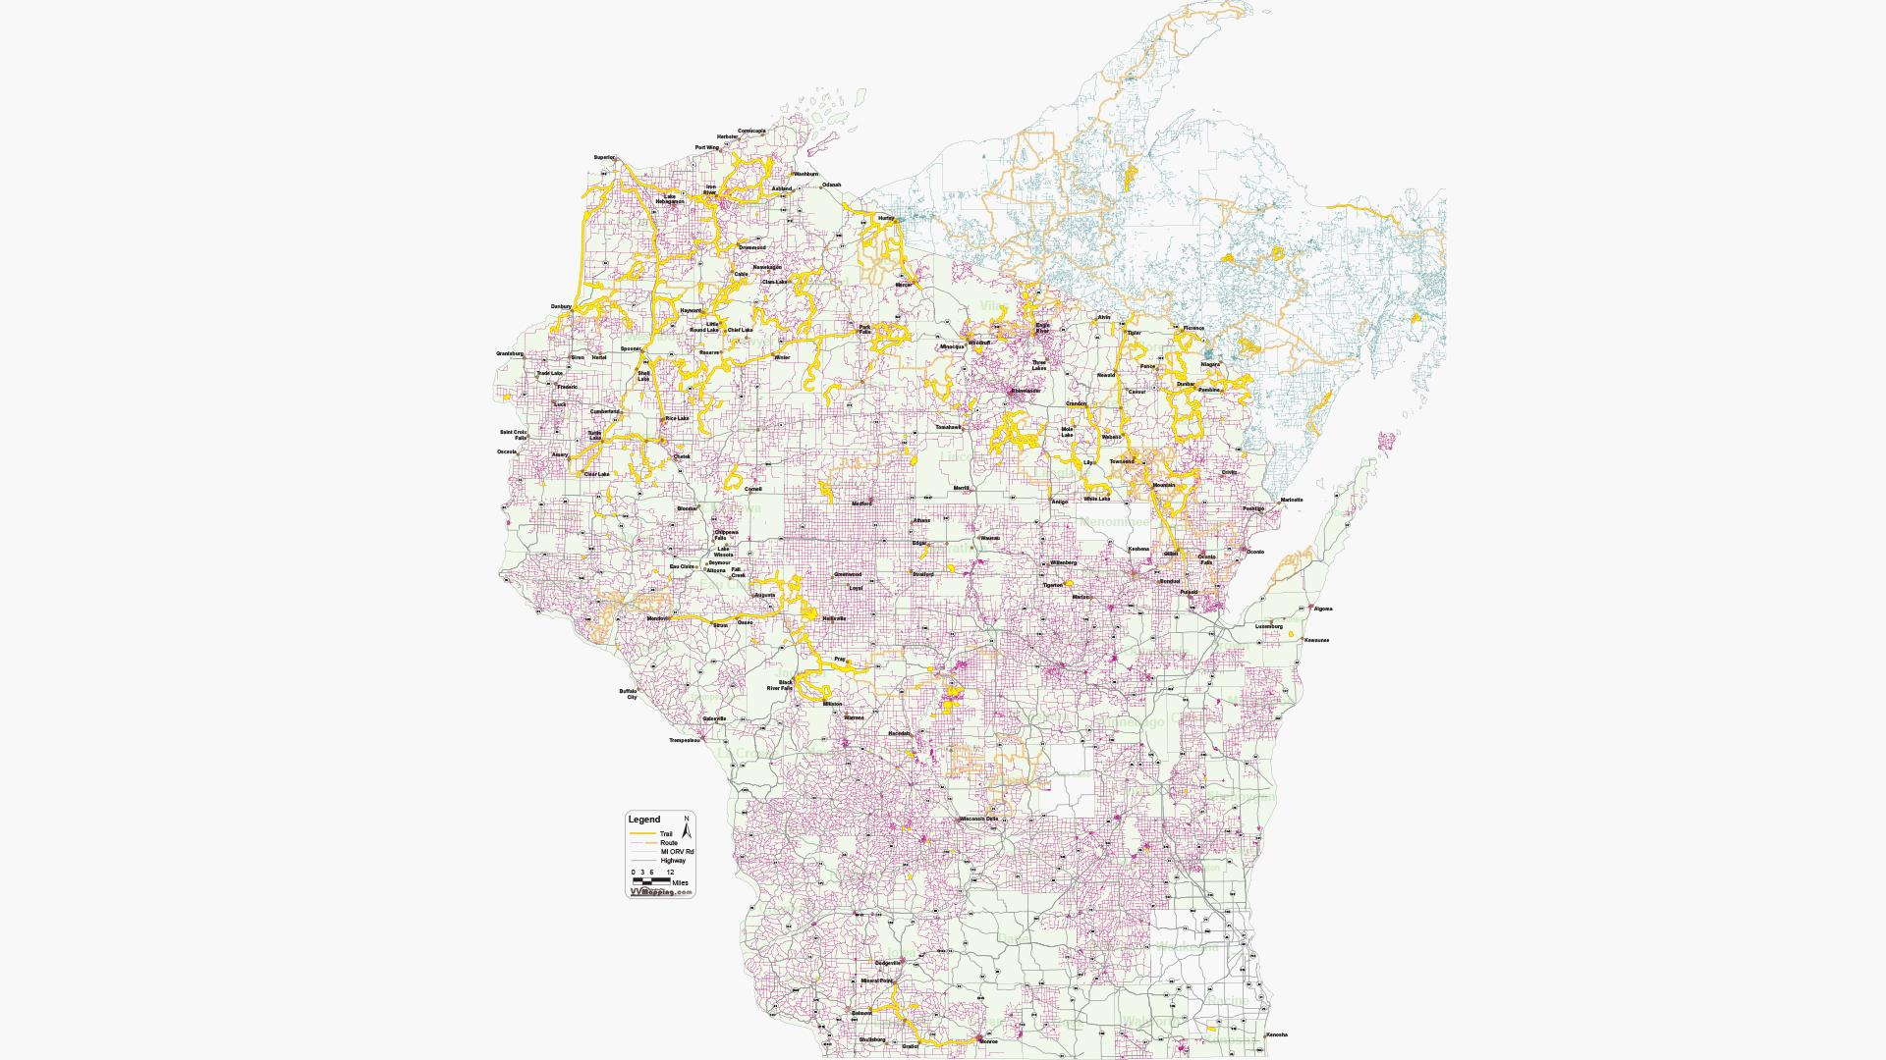
2022

Slide 28
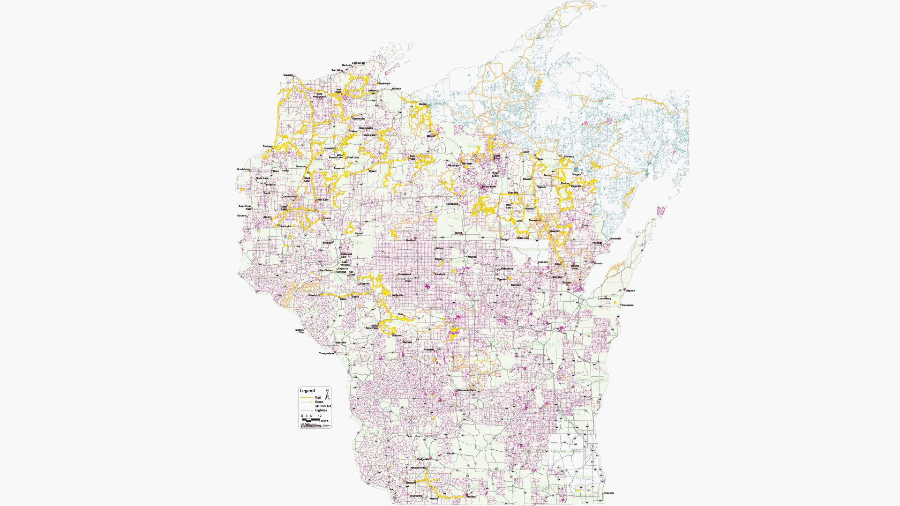
2023

Slide 29
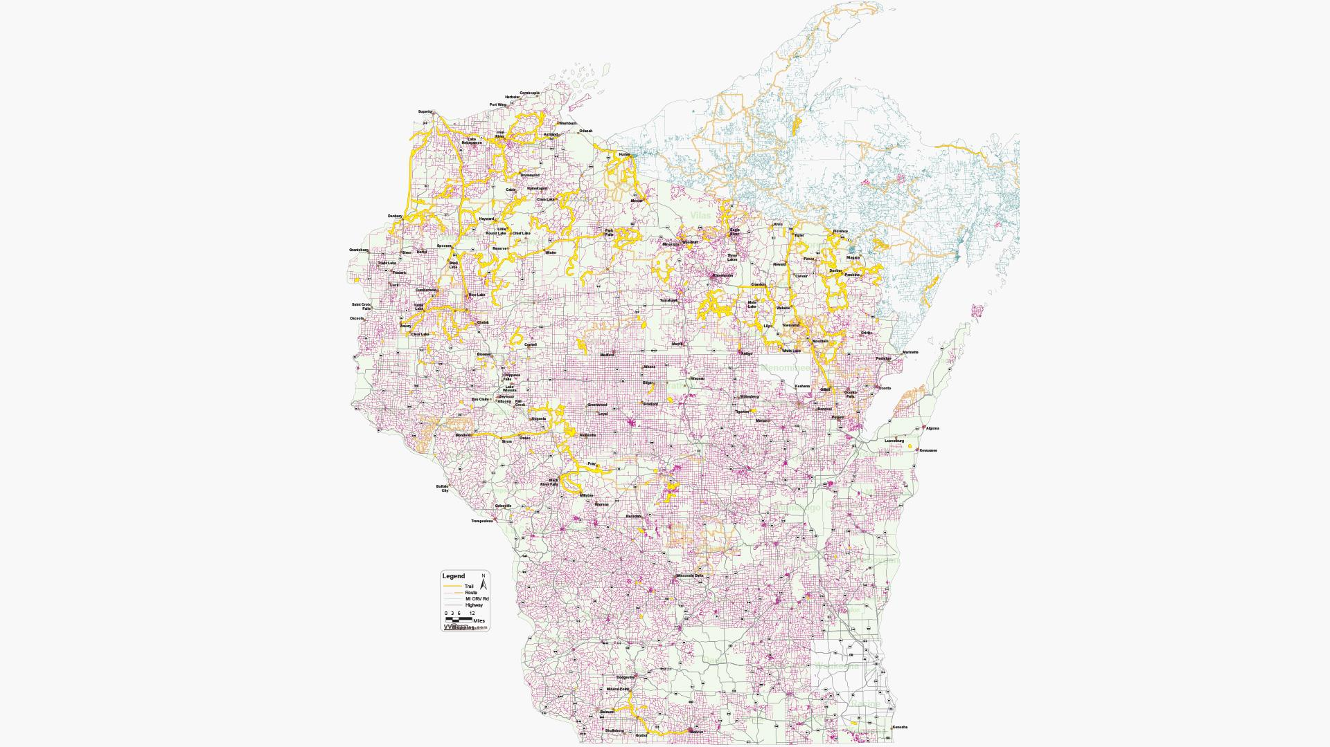
2024

Slide 30
2017 vs ‘24

Slide 31
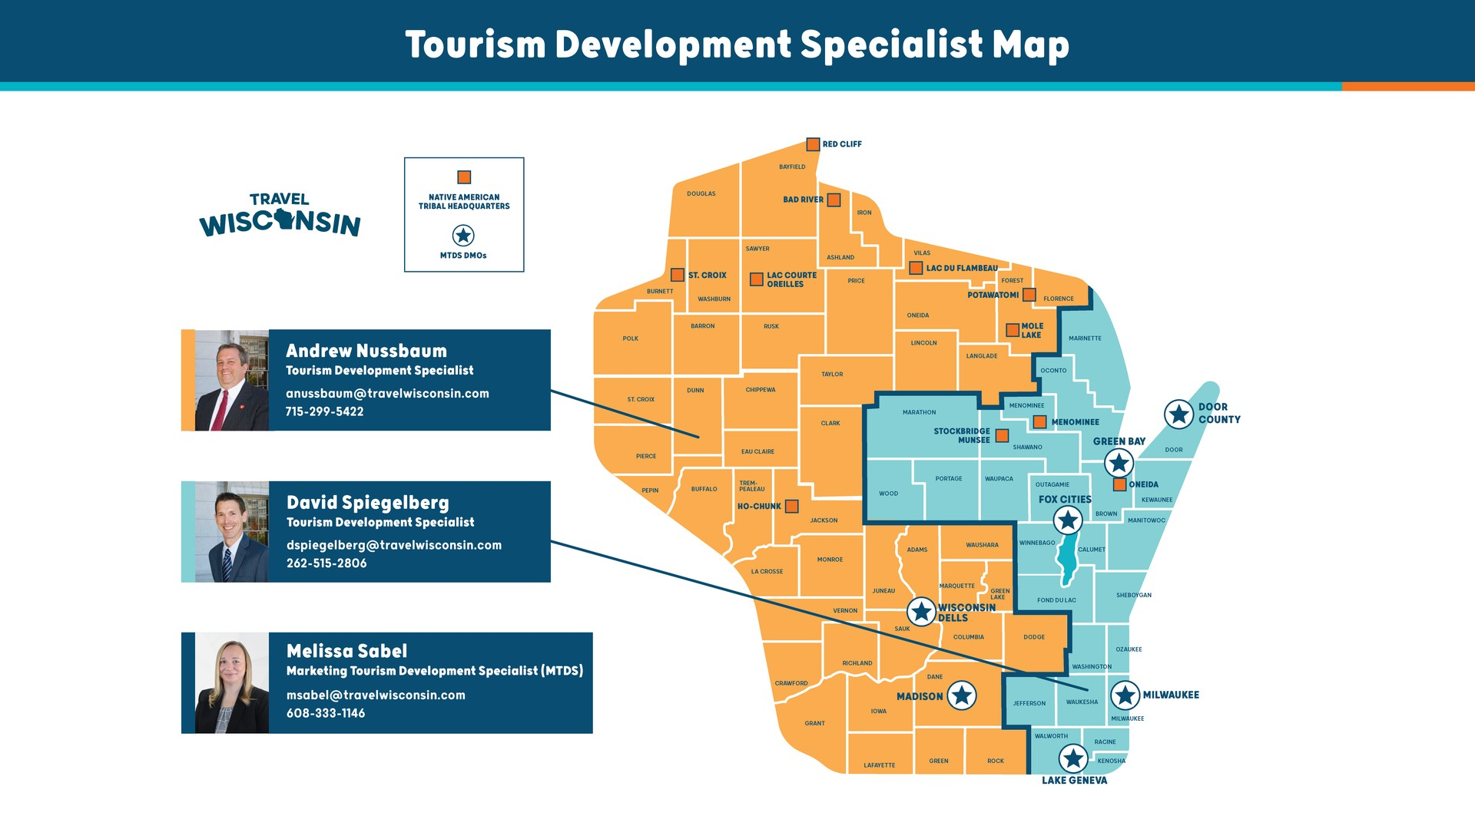

Slide 32
Out of state reciprocation issue -
Montana & South Dakota
Out of state LLC licensing. What is it?
Currently not recognized in Wisconsin but case is being heard in the Wisconsin Supreme Court.
It will potentially impact trail issues related to some larger machines being “road legal” but not trail legal.
Depending on outcome, what steps to take?
Policy changes?
Legislative changes?

Slide 33
Polaris XD1500 Crew others?
AB1133 - Rep. Magnafici introduced but bill is dead until next session. Increased maximum weight from current 3,000 lbs to 3,500 lbs
WATVA is non-committal without input from program partners & trail clubs
Last increase was due to different scenarios, hundreds if not thousands of improperly registered machines plus there was no ramification for improper of fraudulent disclosures on application
This legislation was NOT brought forward by WATVA but we will be asked our opinion if/when brought forward again
Oppose, support or neutral? Requesting program partner insights

Slide 34
Omnibus Legislation - SB 959
Update the careless operation of an ATV or UTV
Allow ATVs and UTVs to cross a bridge of any length
Eliminate the 35 miles per hour restriction for a highway (qualifier)
Allow operation of an ATV and UTV on any roadway if the operation is for emergency purposes during a declared emergency
Expand the definition of “authorized emergency vehicle”
Create the definitions for off-road patrol vehicles
Revises the Department of Transportation (DOT) Highway Maintenance Manual (HMM) to remove the restriction from using short segments of state trunk highways to connect ATV routes or trails to businesses along the highway.
Notes:
Update the careless operation of an ATV or UTV statute to include reckless or negligent operation and allow for damage recovery by the person responsible for maintenance of the property.
Allow ATVs and UTVs to cross a bridge of any length that is otherwise closed to ATV/UTV traffic provided the municipality and the county where the bridge is located approve a resolution allowing it. The current maximum length set in statute is 1,000 feet. This change also eliminates the requirement to stop before crossing the bridge. Oftentimes, these users are trying to reach connecting trails, refueling stations, or go to a restaurant. Eliminating the 1,000 foot requirement maintains local control while allowing for greater ATV/UTV access to businesses and connecting trails.
Eliminate the 35 miles per hour restriction for a highway within the territorial boundaries of a municipality, regardless of whether the municipality has jurisdiction over the highway.
Allow operation of an ATV and UTV on any roadway if the operation is for emergency purposes during a declared emergency.
Expand the definition of “authorized emergency vehicle” to include ATVs, UTVs and snowmobiles operated by law enforcement, fire departments, conservation wardens and ambulance services.
Create the definitions for “patrol all-terrain vehicle”, “patrol utility terrain vehicle”, “patrol off-highway motorcycle” and “patrol snowmobile”. The bill exempts those vehicles from certain operation limitations when responding to emergency or violations of the law, while using sirens and lights.
Revises the Department of Transportation (DOT) Highway Maintenance Manual (HMM) to remove the restriction from using short segments of state trunk highways to connect ATV routes or trails to businesses along the highway.

Slide 35
Open Intox
Senate Bill 262 authored by Senator Jacque
AB 260 authored by Representative Mursau
Assigned to Senate Judiciary and Public Safety Committee
Public hearing held on 8/22/23
Had 22 total lawmakers sign on to sponsor or co-sponsor
Supported by the Tavern League of Wisconsin
Committee chair advised us he did not have enough votes to get it out of the committee without officially calling for a vote, effectively killing this bill

Slide 36
SB 999 MFL Bill - Sen. Felzkowski & Rep. Green
Open Managed Forest Lands w/roads & trails must permit public access for certain vehicles
Requires WISDOT to administer a new MFL road repair grant program
Damage only, not improvements
New appropriation listed as 20.395(1)(mr)
Bill had a public hearing but ran out of time to get through the process
Sponsor advises us they are unsure if they will bring it back next session but if they do, adjustments and changes will be made

Slide 37
Legislative Accomplishments - History
2007 Act 209:
  Created a UTV (Light Utility Vehicle) Pilot Test program that was conducted for several years.
2009 Act 20:
  Extended UTV (Light Utility Vehicle) Pilot Program
2011 Act 208:
  Provided permanent registration and updated regulations for UTVs.
  Introduced major changes, including defining a UTV, aligning UTVs with ATV laws, requiring operators to be at least 16 years old and have ATV Safety Certification, registration categories, new non-resident 5-day ATV/UTV trail pass, late registration renewal fee, funding for ATV trails allowing UTVs, rear license plate, registration free weekend, expiration date of registrations, tampering of odometers.
2013 Act 15:
  Youth safety bill/grandparents bill relating to age restrictions, safety certificates, and speed reductions regarding the operation of an ATV.

Slide 38
Legislative Accomplishments - History
2013 Act 16:
  Created Governors ORV Council.
2013 Act 316:
  Allowed the operation of an ATV or UTV on the roadway or shoulder of a highway for the purpose of crossing a bridge, even if the roadway is officially closed to ATV or UTV traffic.
2017 Act 87:
  Authorized cities, villages, or towns to enact ordinances allowing the operation of all−terrain vehicles and utility terrain vehicles on specific highways with speed limits of 35 mph or less within their territorial boundaries.
2017 Act 193:
  Provided guidelines for political subdivisions to designate ATV routes, erect signs, and allowed the designation of all highways within territorial boundaries as ATV routes.

Slide 39
Legislative Accomplishments - History
2017 State Budget:
  Reinstated the Safety Enhancement Program – Trail Patrol Ambassador program.
2019 Act 183:
  Eliminated the requirement for low-pressure or non-pneumatic tires on ATVs and UTVs.
  Provided a measurement method for the width of an ATV or UTV
  Introduced various modifications and exemptions related to registration, auxiliary lighting, dimming high beams for oncoming vehicles, operation during emergencies, acquisition of communications equipment, compliance with stop signs or other regulatory signs, and safety information sign funding for nonprofit organizations.
2021 Act 70:
  Increased weight definition for UTVs to 3,000 lbs.

Slide 40
Legislative Accomplishments - History
2021 Act 103:
  Eliminated the 40’ rule requiring the need for a light barrier during nighttime travel.
2021 Act 164:
  Local authorities may designate highways as ATV routes, with the ability to post specific speed limits for ATVs and UTVs.
2021 Act 176:
  Combined six DNR ATV and UTV appropriations into three, streamlining funding.
2023 Act 67:
  Moved mapping app and communications for TPA program from ORV council to DNR LE budget with a yearly appropriation.

Slide 41
Legislative Accomplishments - History
2023 State Budget:
  Increased maximum summer trail maintenance funding for ATV trails allowing UTVs from $200/mile to $400/mile.
  Increased funding for County ATV/UTV Law Enforcement grants to $1.3 million.
  Increased by 3 the number of positions for the warden team in the State Budget.

Slide 42
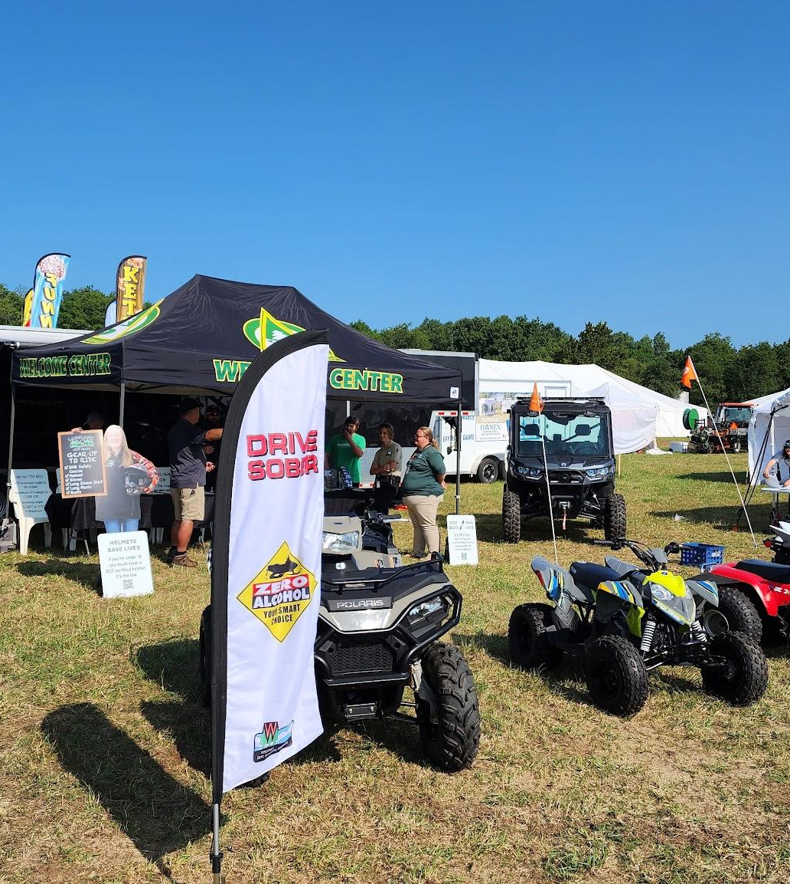
Issues for WATVA to be aware of
Issues or topics of concern?

